Slide 1
Introduction to Graphics CHP 5 Lecture 2
Geometric Shape Assembly & Rasterization
Dr. Ubaid Abbasi

Slide 2
Assembly and Rasterization
Geometric Shape Assembly Process
In this stage geometric shape is assembled from the specified vertex coordinates. The first argument of gl.drawArray() specifies which type of shape should be assembled. Also called primitive assembly process.
Rasterization Process
In this stage, the geometric shape assembled in the geometric assembly process is converted into fragments.

Slide 3
Assembly and Rasterization

Slide 5
Fragment Shader Invocations

Slide 6
Fragment Shader Invocations
Can we control the coloring of each Fragment?
gl.drawingBufferWidth and gl.drawingBufferHeight provides the width and height of Canvas

Slide 7
Color Interpolation
How WebGL Handle different Colors for different Vertices?

Slide 8
Color Interpolation
This process is called Color Interpolation

Slide 9
Texture Mapping
Drawing an image like this is very difficult using color interpolation.
The problem is resolved using a technique called texture mapping , which can re-create the look of real-world materials.

Slide 10
Texture Mapping
The process is actually straightforward and consists of pasting an image on the surface of a geometrical shape.
By pasting an image from a real-world photograph on a rectangle made up of two triangles, you can give the rectangle surface an appearance similar to that of a picture. The image is called a texture image or a texture .

Slide 11
Process
The role of the texture mapping process is to assign the texture image’s pixel colors to the fragments generated by the rasterization process.
The pixels that make up the texture image are called texels (texture elements), and each texel codes its color information in the RGB or RGBA format

Slide 12
Four Steps for Mapping
Texture mapping involves the following four steps in WebGL:
1. Prepare the image to be mapped on the geometric shape.
2. Specify the image mapping method for the geometric shape.
3. Load the texture image and configure it for use in WebGL.
4. Extract the texels from the image in the fragment shader, and accordingly set the corresponding fragment.

Slide 14
Texture Coordinates
Texture coordinate system in WebGL is two dimensional
To differentiate the texture coordinates from the widely used x and y axis, WebGL
128×128 or 128×256, the right top corner coordinates will always be(1.0, 1.0)

Slide 15
Pasting Texture Images to Geometric Shape
The texture coordinates (0.0, 1.0) are mapped onto the vertex coordinates (–0.5, 0.5,0.0), and the texture coordinates (1.0, 1.0) are mapped onto the vertex coordinates (0.5,0.5, 0.0).

Slide 16
TextureQuad.JS

Slide 17
TextureQuad.JS

Slide 21
Steps For Texture Mapping
This program is structured into five main parts:
Part 1: Receive the texture coordinates in the vertex shader and then pass them to the fragment shader.
Part 2: Paste the texture image onto the geometric shape inside the fragment shader.
Part 3: Set the texture coordinates ( initVertexBuffers() ).
Part 4: Prepare the texture image for loading, and request the browser to read it.( initTextures() ).
Part 5: Configure the loaded texture so that it can be used in WebGL ( loadTexture() ).

Slide 22
Using Texture Coordinates
The first vertex (–0.5, 0.5) is mapped to the texture coordinate (0.0, 1.0),
The second vertex (–0.5, –0.5) is mapped to the texture coordinate (0.0, 0.0),
The third vertex (0.5, 0.5) is mapped to the texture coordinate (1.0, 10), and
The fourth vertex (0.5,–0.5) is mapped to the texture coordinate (1.0, 0.0).

Slide 23
Setting Up and Loading Images (initTextures())
Creates a texture object ( gl.createTexture() ) for managing the texture image in the WebGL system,
Gets the storage location of a uniform variable (gl.getUniformLocation()) to pass the texture image to the fragment shader ()

Slide 24
createTexture() Method
gl.TEXTURE0 to gl.TEXTURE7 are texture units for managing a texture image, and each has an associated gl.TEXTURE_2D , which is the texture target for specifying the type of texture.

Slide 25
Asynchronous Loading Texture Images

Slide 26
Making Texture Ready to Use

Slide 27
Flip an Image Y-Axix

Slide 28
Flip an Image Y-Axix

Slide 29
Active Texture Unit

Slide 30
Active Texture Unit

Slide 31
Binding a Texture Object

Slide 32
Binding a Texture Object

Slide 33
Setting the Texture Parameters

Slide 34
Setting the Texture Parameters

Slide 35
Setting the Texture Parameters

Slide 36
Setting the Texture Parameters

Slide 37
Assigning Texture Image to a Texture Object

Slide 38
Assigning Texture Image to a Texture Object

Slide 39
Assigning Texture Image to a Texture Object

Slide 40
Assigning Texture Image to a Texture Object

Slide 41
Retrieving the Texel Color

Slide 42
Return Values of texture2D()

Slide 43
WebGL System After Retrieving Texture

Slide 44
Basic Strategy
Three steps to applying a texture
specify the texture
read or generate image
assign to texture
enable texturing
assign texture coordinates to vertices
Proper mapping function is left to application
specify texture parameters
wrapping, filtering

Slide 45
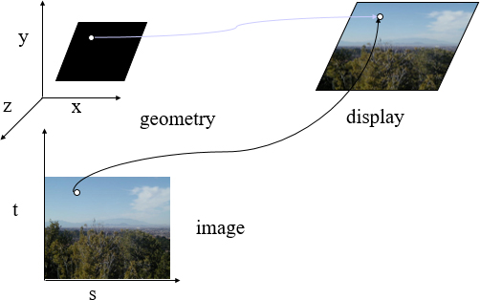
Texture Mapping

Slide 46
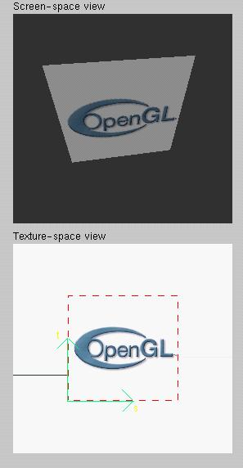
Texture Example
The texture (below) is a
image that has been mapped to a rectangular polygon which is viewed in perspective

Slide 47
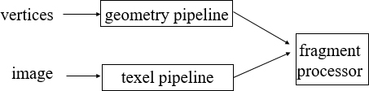
Texture Mapping and the Web G L Pipeline
Images and geometry flow through separate pipelines that join during fragment processing
“complex” textures do not affect geometric complexity

Slide 48
Specifying a Texture Image
Define a texture image from an array of texels (texture elements) in C P U memory
Use an image in a standard format such as J P E G
Scanned image
Generate by application code
Web G L supports only 2 dimensional texture maps
no need to enable as in desktop Open G L
desktop Open G L supports 1-4 dimensional texture maps

Slide 49
Define Image as a Texture

Slide 50
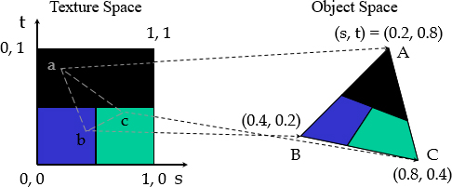
Mapping a Texture
Based on parametric texture coordinates
Specify as a 2D vertex attribute

Slide 51
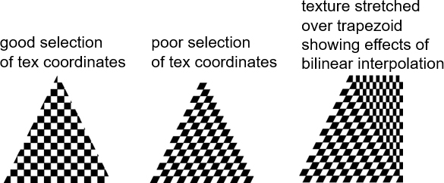
Interpolation
Web G L uses interpolation to find proper texels from specified texture coordinates
Can be distortions

Slide 52
Using Texture Objects
specify textures in texture objects
set texture filter
set texture function
set texture wrap mode
set optional perspective correction hint
bind texture object
enable texturing
supply texture coordinates for vertex

Slide 53
Texture Parameters
Web G L has a variety of parameters that determine how texture is applied
Wrapping parameters determine what happens if s and t are outside the (0,1) range
Filter modes allow us to use area averaging instead of point samples
Mipmapping allows us to use textures at multiple resolutions
Environment parameters determine how texture mapping interacts with shading

Slide 54
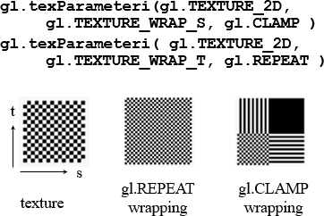
Wrapping Mode
Clamping: if s,t > 1 use 1, if s,t <0 use 0
Wrapping: use s,t modulo 1

Slide 55
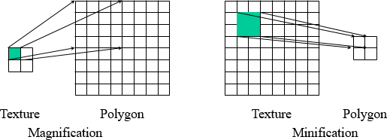
Magnification and Minification
More than one texel can cover a pixel (minification) or more than one pixel can cover a texel (magnification)
Can use point sampling (nearest texel) or linear filtering
to obtain texture values

Slide 56
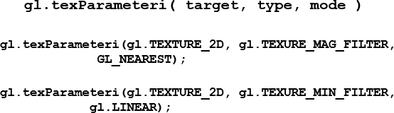
Filter Modes
Modes determined by

Slide 57
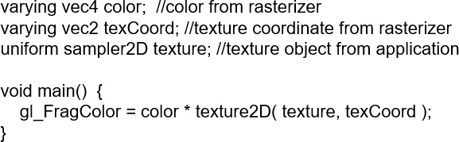
Applying Textures
Textures are applied during fragments shading by a sampler
Samplers return a texture color from a texture object

Slide 58
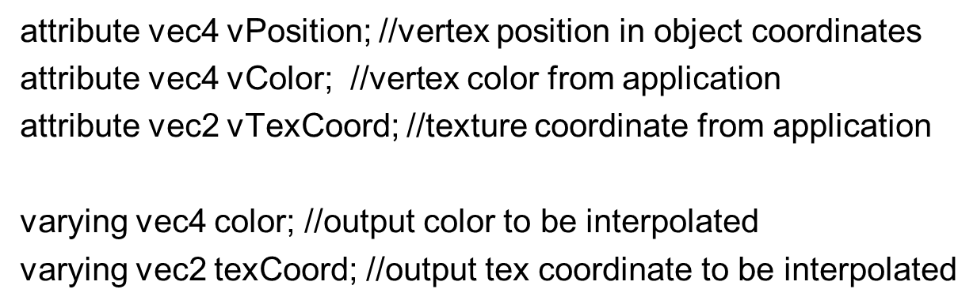
Vertex Shader
Usually vertex shader will output texture coordinates to be rasterized
Must do all other standard tasks too
Compute vertex position
Compute vertex color if needed

